Slide 1
MEDTRACK_DV
Turning Hospital Data into Clear, Visual Answers
Hospital Operations & Patient Analytics Dashboard • Power BI + Tableau
Prepared by: Nihal Kata
Infosys Springboard 7.0 — Data Visualization (Batch 2)
CMR College of Engineering and Technology, B.Tech / Data Science

Slide 2
The Problem: Hospital Data Is Scattered
Hospitals generate information from many daily activities, but these measures are often viewed separately.
Patient Admissions
Admission information is recorded across hospital operations.
Patient Movement
Admissions, discharges and patient stays need to be monitored.
Department Performance
Department-level performance and efficiency need to be compared.
Beds, Staff & Resources
Occupancy and resource usage need to be understood.
THE CHALLENGE
When these measures are viewed separately, it becomes difficult to understand the overall operational situation of the hospital.
WHY IT MATTERS
A unified analytical view can help users compare performance, observe trends and identify areas requiring attention.
MedTrack_DV | Hospital Operations & Patient Analytics Dashboard
2

Slide 3
The Journey: 7 Modules, Start to Finish
Each stage's output feeds directly into the next
1
2
3
4
5
6
7
Data
Generation &
Integration
→
Data
Cleaning &
Preparation
→
KPI
Engineering
→
Dashboard
Storyboard
→
Dashboards
1 & 2
→
Dashboards
3 & 4
→
Final
Integration &
Testing
Result: raw hospital records become a cleaned dataset, then measurable KPIs, then a planned layout, and finally four interactive dashboards — built twice, in Power BI and Tableau, then tested end to end.
MedTrack_DV | Hospital Operations & Patient Analytics Dashboard
4

Slide 4
Tools & Technologies Behind the Scenes
A simple, familiar stack — nothing exotic, just used well
🐍
📊
📓
📄
Python
Pandas / NumPy
Jupyter Notebook
CSV & Excel
Generating & integrating data, building KPIs
Cleaning & transforming data
Step-by-step data cleaning
Raw, cleaned & final datasets
📈
📉
🗂
📋
Power BI
Tableau
GitHub
PDF
Building interactive dashboards
A second, parallel dashboard build
Storing & organizing every module
The dashboard storyboard plan
MedTrack_DV | Hospital Operations & Patient Analytics Dashboard
5

Slide 5
From Messy Records to a Ready Dataset
Modules 1–2: generate, clean, and turn data into KPIs
→
→
🗃
🧹
✅
Raw Hospital Data
Cleaned Dataset
Final Analytical Dataset
hospital_raw_data.csv — generated & integrated with Python
hospital_cleaned.csv — missing values fixed, duplicates removed, fields standardized
hospital_final_dataset.xlsx — enriched with KPIs, ready for dashboards
Cleaning activities: fixed missing values • removed duplicates • standardized department names • prepared fields for KPIs
MedTrack_DV | Hospital Operations & Patient Analytics Dashboard
6

Slide 6
The KPIs That Power the Dashboards
Module 3: Six measures turn raw numbers into hospital performance stories
🧾
Total Admissions
🏨
Occupancy Rate
⏱
Avg. Length of Stay
How many patients came in
How full the hospital is running
How long patients typically stay
🔁
Readmission Rate
🛏
Bed Utilization Rate
⚙
Department Efficiency Score
How often patients come back
How well beds are being used
How departments compare
MedTrack_DV | Hospital Operations & Patient Analytics Dashboard
7

Slide 7
Four Dashboards, One Full Picture
Module 4-7: Each built twice — once in Power BI, once in Tableau
Hospital Overview
Patient Flow
🏥
🚶
Big-picture KPIs — admissions, occupancy, revenue, efficiency at a glance
Admissions, discharges, patient movement and length-of-stay trends
Department Analytics
Resource Utilization
🩺
📦
Volume, performance and efficiency compared across departments
Beds, staff and equipment — how operational resources are used
MedTrack_DV | Hospital Operations & Patient Analytics Dashboard
8

Slide 8
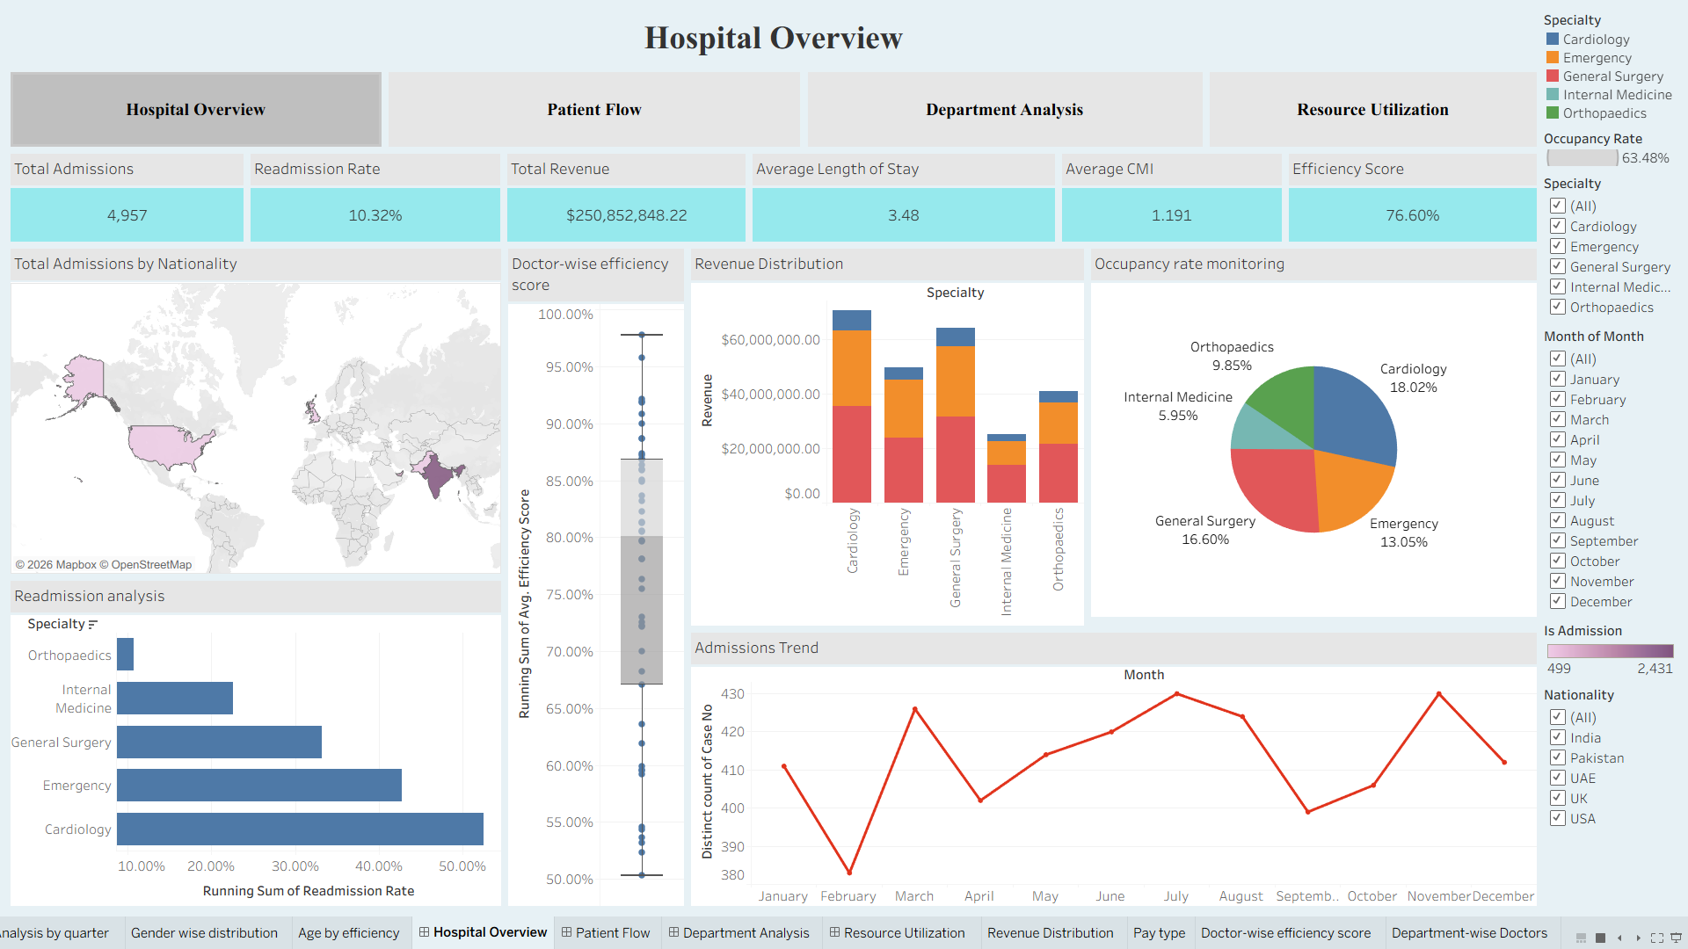
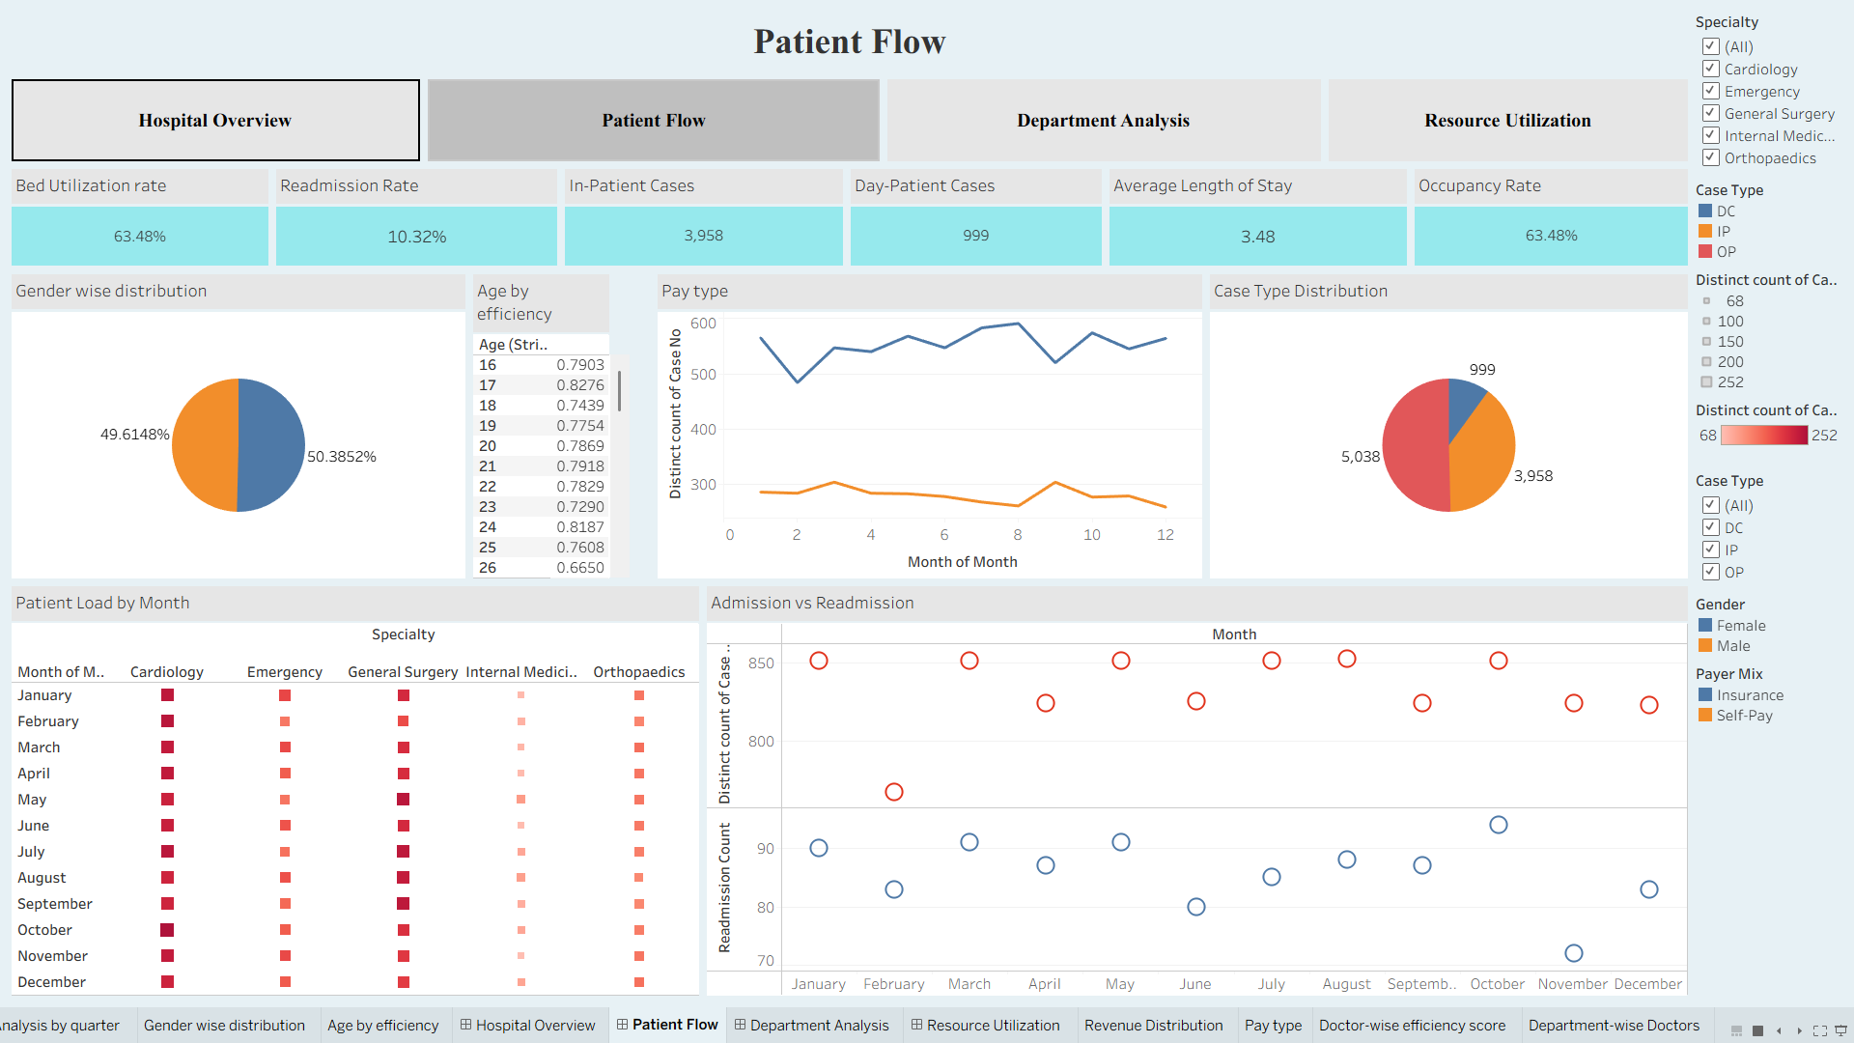
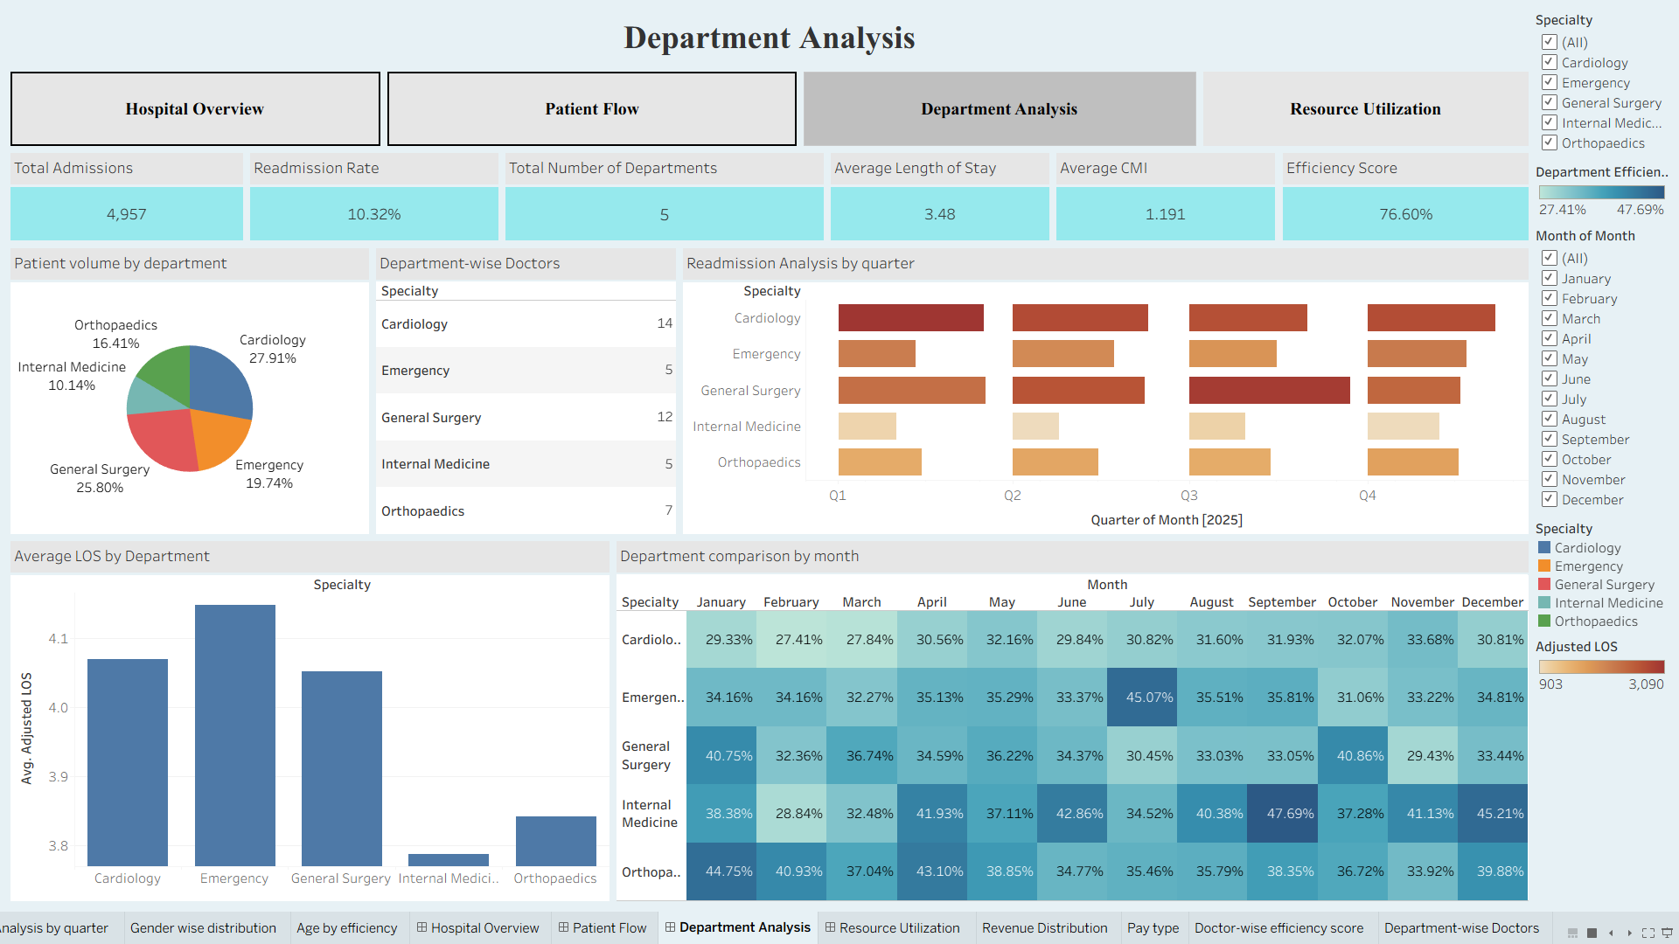
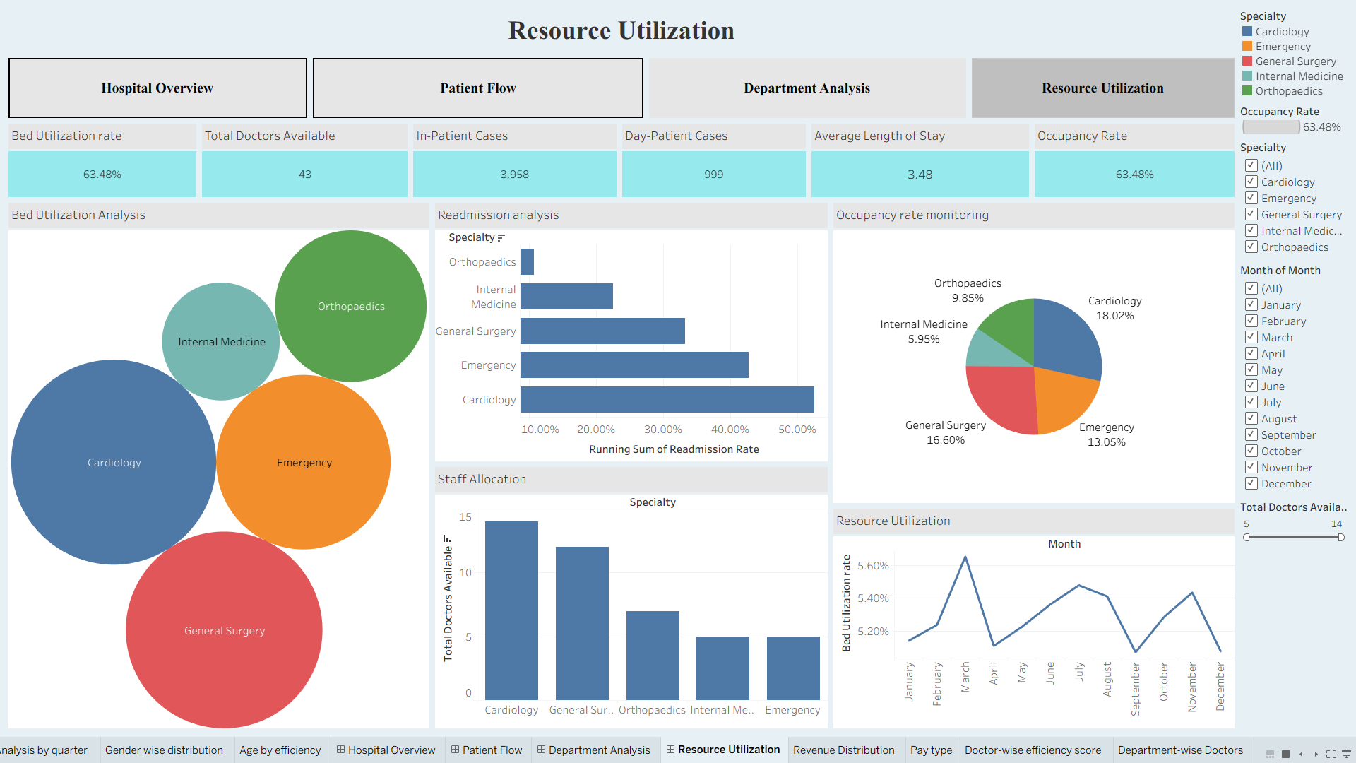

Slide 9
Making Sure Everything Actually Works
Module 8: final integration, then a full round of testing
✓
KPI calculations match the prepared data
✓
Correct final dataset is used everywhere
✓
Filters affect the right charts and KPIs
✓
Navigation between dashboards works
✓
Interactive actions & selections behave correctly
✓
Power BI report opens cleanly with all visuals
✓
Tableau workbook opens cleanly with all visuals
✓
Layout, labels and readability hold up on final review
Final files delivered: medtrack_prototype.pbix • medtrack_prototype.twb • README.md — all organized on GitHub
MedTrack_DV | Hospital Operations & Patient Analytics Dashboard
9

Slide 10
Real-World Questions & Impact
How can a hospital actually use these dashboards in day-to-day decision making?
Are admissions increasing or decreasing?
Which departments need attention?
Helps teams understand changing patient demand.
Makes department-level differences easier to identify.
How full is the hospital?
How long are patients staying?
Supports awareness of occupancy and bed capacity.
Helps understand patient stay patterns and flow.
Are beds and resources being used well?
Are patients returning after discharge?
Supports better operational resource planning.
Readmission trends can highlight areas for closer review.
Overall impact
Faster understanding • Better monitoring • Easier comparison • More informed operational decisions
10

